Slide 1



SAE NIS EFFI-CYCLE >>>Drive The Future<<< CAD Report
Place College/ Team Logo within this space
<Effi20055>
<Samanvaya Racing>
Notes:
Purpose of the CAD Report: While giving presentations to judges, there may not be a facility to open cad model and explain. Hence, this cad report will serve the purpose of anything related to any component needs to be viewed.

Slide 2
General Guidelines
0
On the left corner of every slide, slide number is given in the box. Do not change slide sequence. Do not use automatic slide numbering.
On the slide number 1, all views of vehicle are required. Pictures are shown for demonstration of views.
On the assembly tree slide (slide number 2), team should add vehicle level assembly tree pictures, in which all subassemblies and child parts are visible. All parts and subassemblies should be constrained in the assembly as per the functional requirement. Team can add additional slide if needed for assembly tree. Additional slide for assembly tree should be numbered as 2a, 2b, etc.
On the next slides (slide number 3 to 9) for subsystem level, there should be isometric view of respective subsystem assembly along with ballooning and table to explain the part name. On slide number 3, illustration image is shown which needs to be replaced with steering subsystem assembly exploded view.
On slide number 10 to 16, include subsystem side, front, top and exploded views. Teams can use sectional views for better understanding wherever necessary. Additional slides can be added for extra view of subsystem or critical components. These additional slides should be numbered according to the respective subsystem slide number with a, b, etc. For example, if team wants to add extra slide for drivetrain subsystem, then it should be added after slide number 13 and numbered as 13a.
All the views should be clearly visible.
Background colour of CAD screen should be white.
Assembly table format is given on the coming slides.

Slide 3
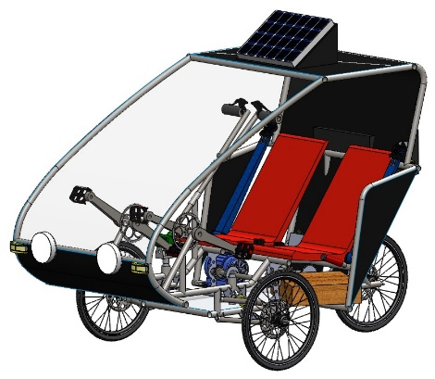
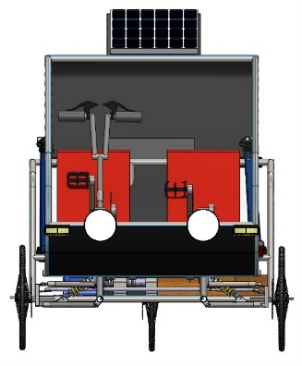
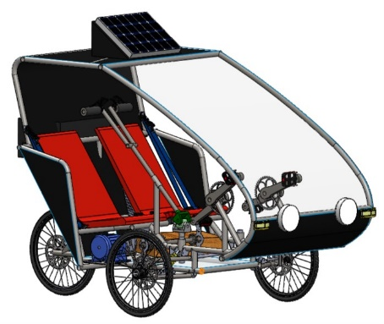
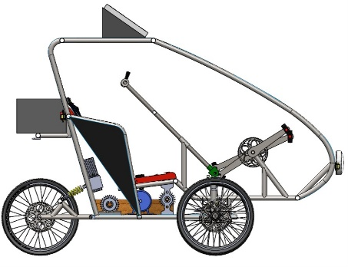
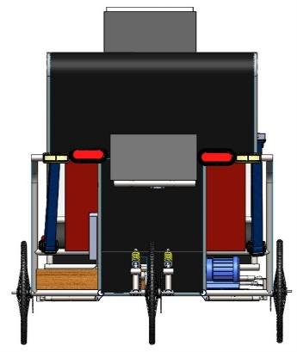
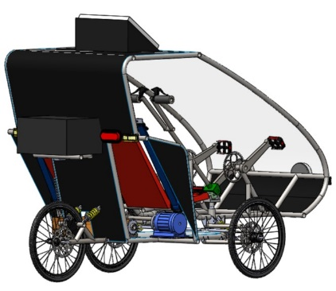
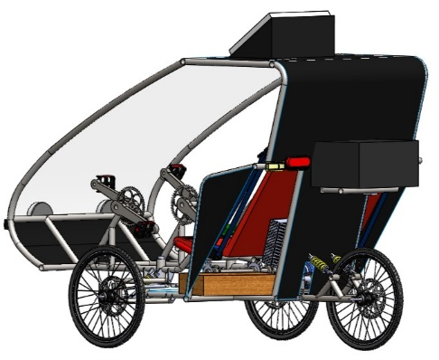
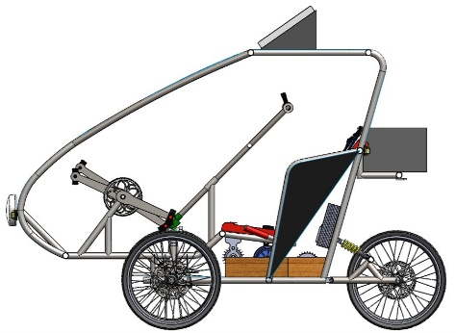
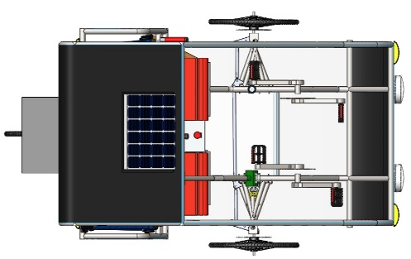
1

Slide 4
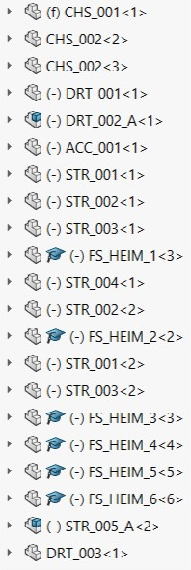
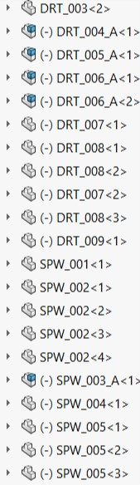
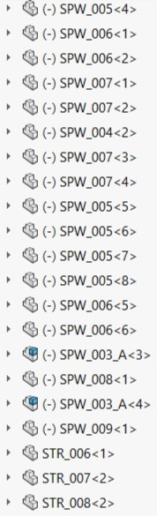
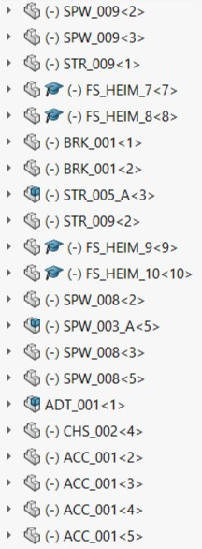
Assembly Tree
2
Snaps of Full Assembly Tree
Snaps of Full Assembly Tree
Snaps of Full Assembly Tree
Snaps of Full Assembly Tree

Slide 5
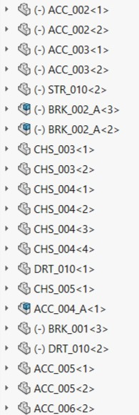
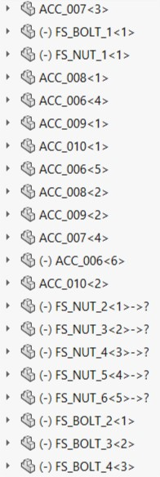
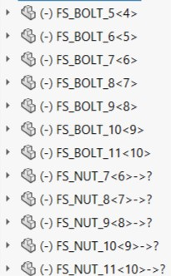
Assembly Tree
2a
Snaps of Full Assembly Tree
Snaps of Full Assembly Tree
Snaps of Full Assembly Tree
Snaps of Full Assembly Tree

Slide 6
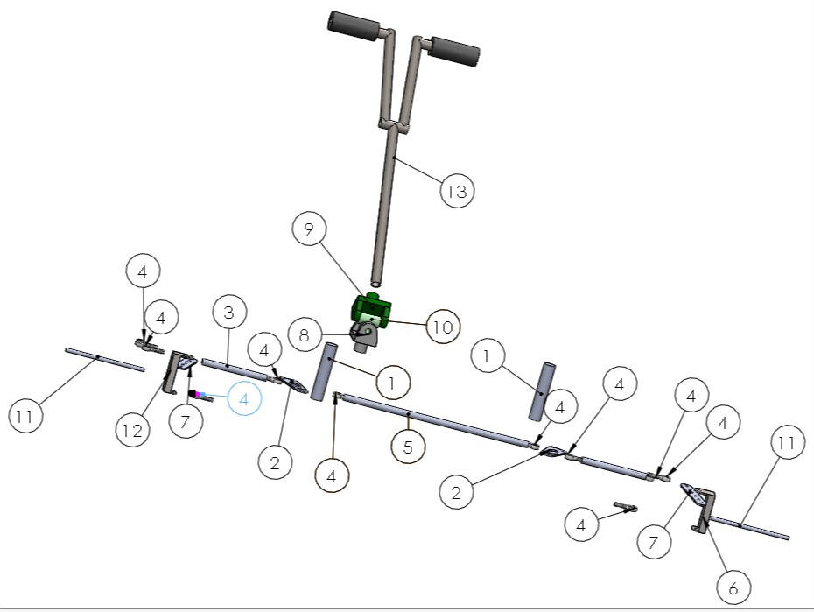
Steering
3
B. No | Part Name
11 | Steering Rod | 29
12 | Knuckle Left | 30
13 | Handle Bar | 31
14 |  | 32
15 |  | 33
16 |  | 34
17 |  | 35
18 |  | 36
19 |  | 37
20 |  | 38
21 |  | 39
22 |  | 40
23 |  | 41
24 |  | 42
25 |  | 43
26 |  | 44
27 |  | 45
28 |  | 46
Isometric Exploded View with Ballooning – Subsystem Full Assembly
B.No | Part Name
1 | 7 inch rod | 6 | Knuckle Right
2 | Crank | 7 | Steering Arm
3 | Side Tyroid | 8 | Driving Yoke
4 | Heim Ball Joint | 9 | Driven Yoke
5 | Center Tyroid | 10 | Bearing Cross

Slide 7
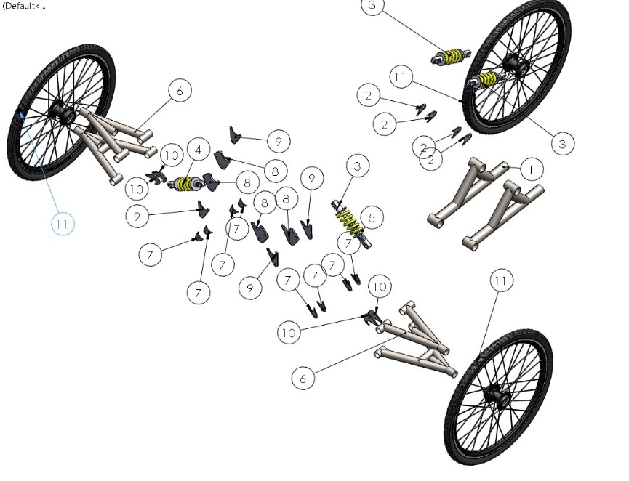
Suspension, Wheels and Tires
4
B.No | Part Name
11 | Wheel Assembly | 29
12 |  | 30
13 |  | 31
14 |  | 32
15 |  | 33
16 |  | 34
17 |  | 35
18 |  | 36
19 |  | 37
20 |  | 38
21 |  | 39
22 |  | 40
23 |  | 41
24 |  | 42
25 |  | 43
26 |  | 44
27 |  | 45
28 |  | 46
Isometric Exploded View with Ballooning – Subsystem Full Assembly
B.No | Part Name
1 | Trailing Arm | 6 | Front Arms
2 | Trailing Arm Clamps | 7 | Lower Arm Clamps
3 | Suspension Rod | 8 | Suspension Mountings
4 | Suspension Spring | 9 | Upper Arms Clamps
5 | Suspension | 10 | Lower Suspension Clamps

Slide 8
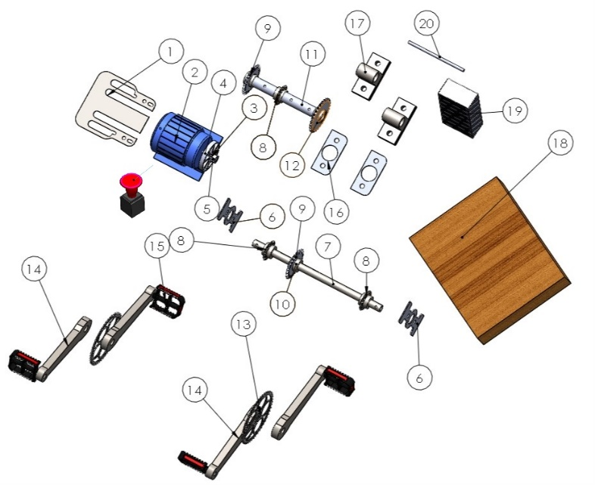
Drivetrain
5
B.No | Part Name
11 | Back Shaft | 29
12 | 28 Teeth Sprocket | 30
13 | Pedal Crank | 31
14 | Pedal Rod | 32
15 | Foot Rest on Pedal | 33
16 | Shaft Hold Mounting | 34
17 | Shaft Holder | 35
18 | Battery | 36
19 | Controller | 37
20 | Kill Switch | 38
21 |  | 39
22 |  | 40
23 |  | 41
24 |  | 42
25 |  | 43
26 |  | 44
27 |  | 45
28 |  | 46
Isometric Exploded View with Ballooning – Subsystem Full Assembly
B.No | Part Name
1 | Motor Mounting | 6 | Vertical Pedestal
2 | Motor | 7 | Front Shaft
3 | Motor Wheel | 8 | 16 Teeth Sprocket
4 | Motor Rotating Rod | 9 | 22 Teeth Sprocket
5 | Motor Gear | 10 | Hub

Slide 9
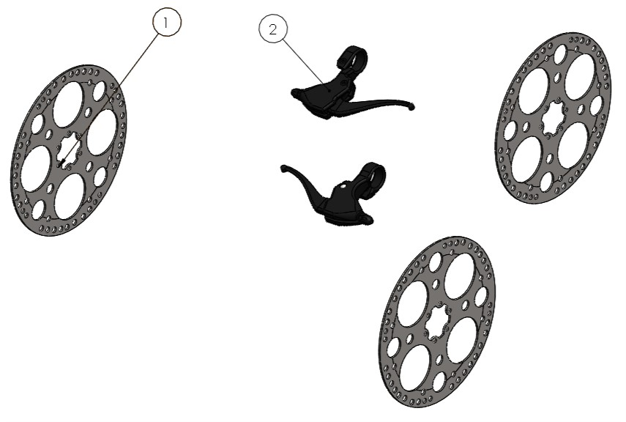
Brakes
6
B.No | Part Name
11 |  | 29
12 |  | 30
13 |  | 31
14 |  | 32
15 |  | 33
16 |  | 34
17 |  | 35
18 |  | 36
19 |  | 37
20 |  | 38
21 |  | 39
22 |  | 40
23 |  | 41
24 |  | 42
25 |  | 43
26 |  | 44
27 |  | 45
28 |  | 46
Isometric Exploded View with Ballooning – Subsystem Full Assembly
B.No | Part Name
1 | Disc | 6
2 | Brake Lever | 7
3 |  | 8
4 |  | 9
5 |  | 10

Slide 10
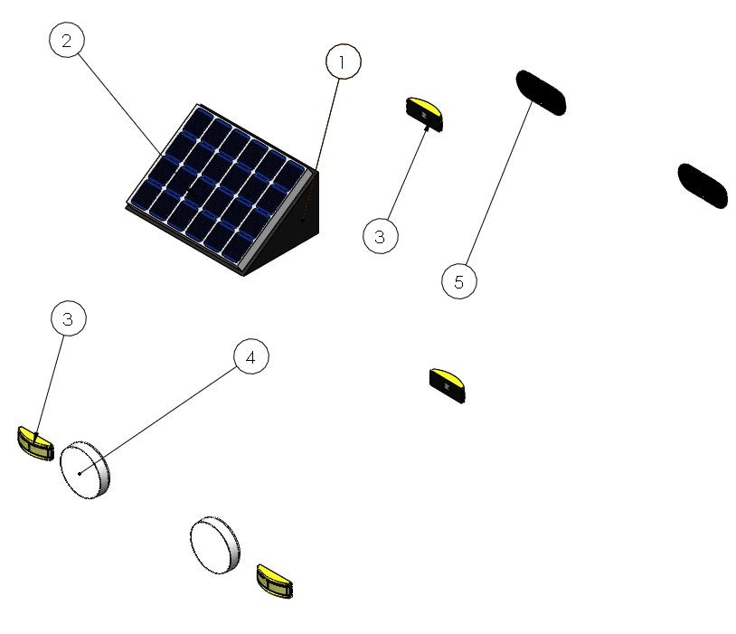
Advance Tech
7
B.No | Part Name
11 |  | 29
12 |  | 30
13 |  | 31
14 |  | 32
15 |  | 33
16 |  | 34
17 |  | 35
18 |  | 36
19 |  | 37
20 |  | 38
21 |  | 39
22 |  | 40
23 |  | 41
24 |  | 42
25 |  | 43
26 |  | 44
27 |  | 45
28 |  | 46
Isometric Exploded View with Ballooning – Subsystem Full Assembly (4 separate)
B.No | Part Name
1 | Solar Panel Stand | 6
2 | Solar Panel | 7
3 | Turn Indicator | 8
4 | Head Light | 9
5 | Brake Light | 10

Slide 11
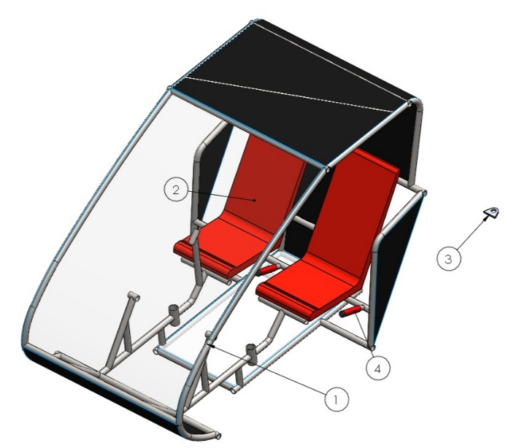
Frame, Seats
8
B.No | Part Name
11 |  | 29
12 |  | 30
13 |  | 31
14 |  | 32
15 |  | 33
16 |  | 34
17 |  | 35
18 |  | 36
19 |  | 37
20 |  | 38
21 |  | 39
22 |  | 40
23 |  | 41
24 |  | 42
25 |  | 43
26 |  | 44
27 |  | 45
28 |  | 46
Isometric Exploded View with Ballooning – Subsystem Full Assembly
B.No | Part Name
1 | Roll Cage | 6
2 | Seat | 7
3 | Towing Point | 8
4 | Hand Hold with Grip | 9
5 |  | 10

Slide 12
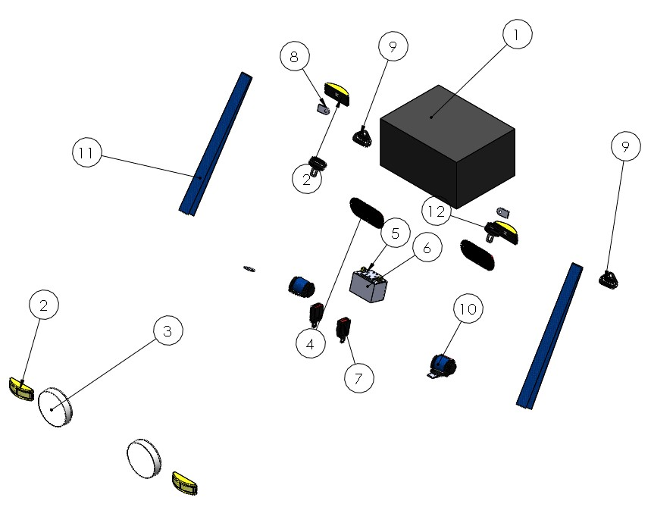
Electrical and Accessories
9
B.No | Part Name
11 | Belt | 29
12 | Knob | 30
13 |  | 31
14 |  | 32
15 |  | 33
16 |  | 34
17 |  | 35
18 |  | 36
19 |  | 37
20 |  | 38
21 |  | 39
22 |  | 40
23 |  | 41
24 |  | 42
25 |  | 43
26 |  | 44
27 |  | 45
28 |  | 46
Isometric Exploded View with Ballooning – Subsystem Full Assembly
B. No | Part Name
1 | Utility Box | 6 | Battery Case
2 | Turn Indicator | 7 | Seat Belt Holder
3 | Head Light | 8 | Seat Belt Clamp
4 | Brake Light | 9 | Seat Belt Shifter
5 | Small Battery | 10 | Seat Belt

Slide 13
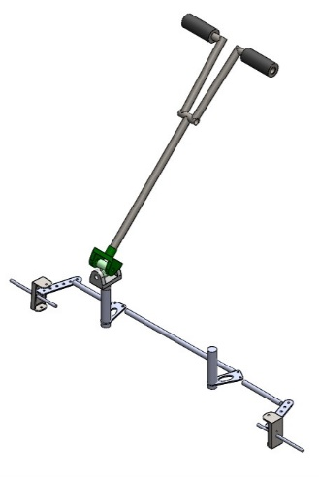
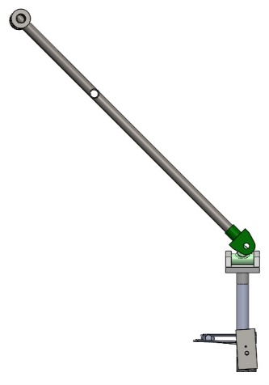
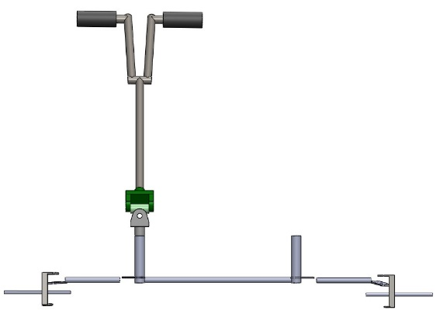
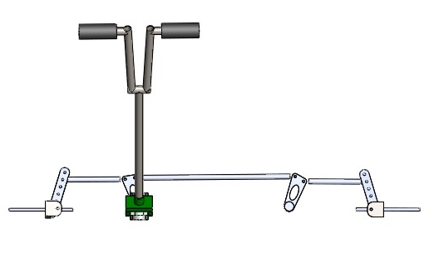
Steering Subsystem
10
Isometric view – Subsystem Assembly
Front view – Subsystem Assembly
Side view – Subsystem Assembly
Top view – Subsystem Assembly
Sectional view – Wherever required for better understanding
Sectional view – Wherever required for better understanding

Slide 14
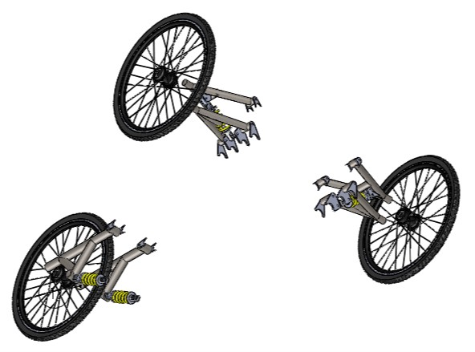
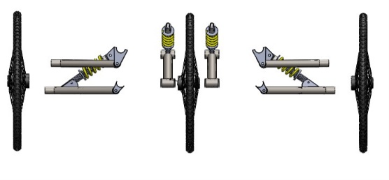
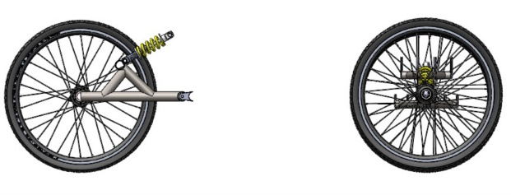
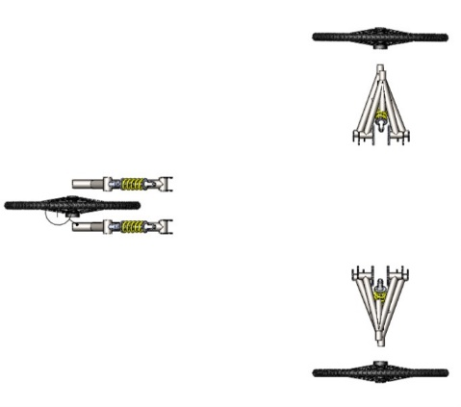
Suspension, Wheels and Tires
11
Isometric view – Subsystem Assembly
Front view – Subsystem Assembly
Side view – Subsystem Assembly
Top view – Subsystem Assembly
Sectional view – Wherever required for better understanding
Sectional view – Wherever required for better understanding

Slide 15
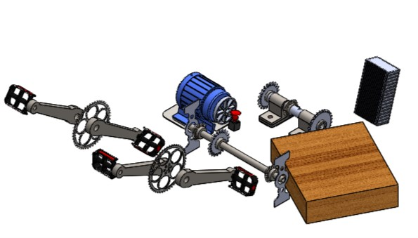
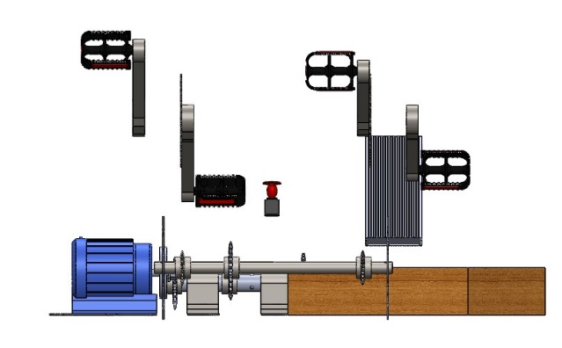
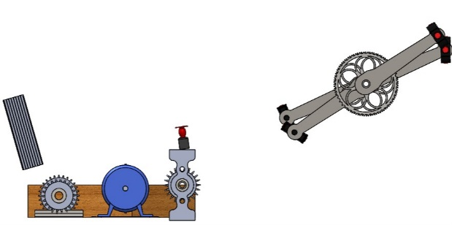
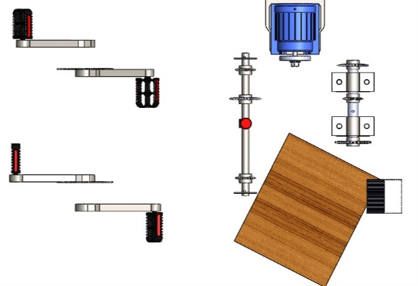
Drivetrain Subsystem
12
Isometric view – Subsystem Assembly
Front view – Subsystem Assembly
Side view – Subsystem Assembly
Top view – Subsystem Assembly
Sectional view – Wherever required for better understanding
Sectional view – Wherever required for better understanding

Slide 16
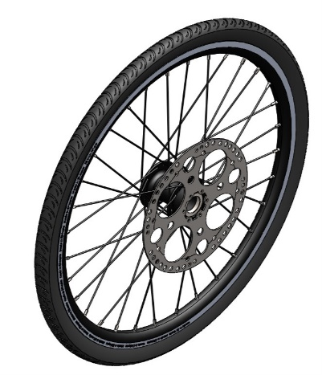
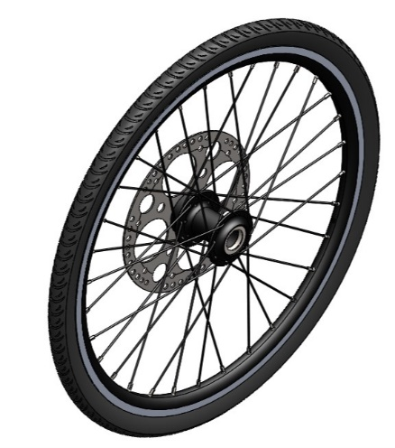
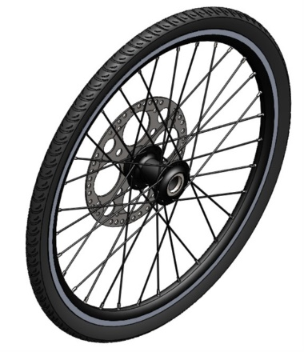
Brakes Subsystem
13
Isometric view – Left Front Wheel Brake system Assembly
Isometric view – Right Front Wheel Brake Assembly
Isometric view – Rear Wheel Brake Assembly
Brake Wire Routing view
Sectional view – Wherever required for better understanding
Sectional view – Wherever required for better understanding

Slide 17
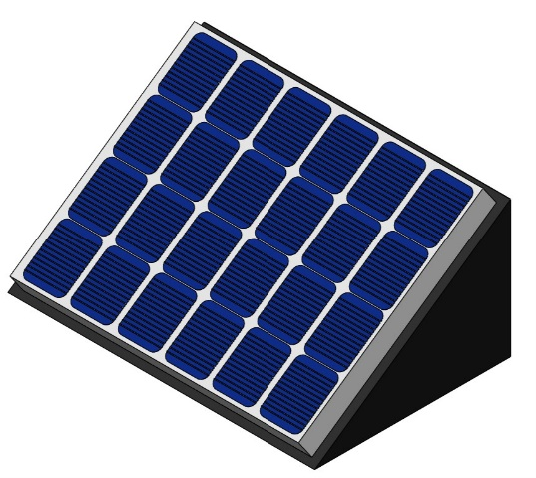
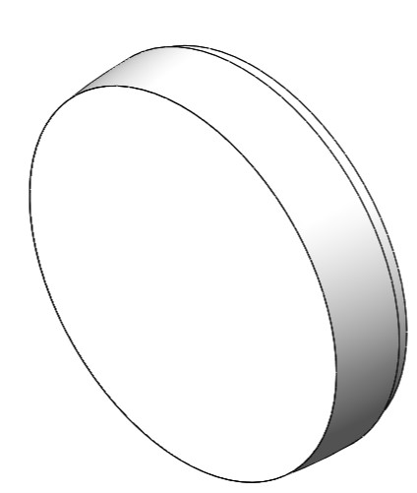
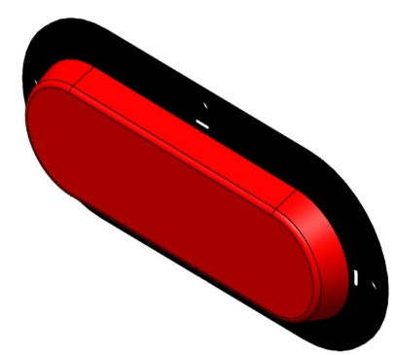
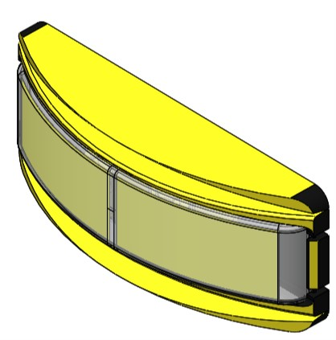
Advance Tech Subsystem
14
Isometric view – Advance Tech 1
Isometric view – Advance Tech 2
Isometric view – Advance Tech 3
Isometric view – Advance Tech 4
Sectional/ Extra view – Wherever required for better understanding
Sectional/ Extra view – Wherever required for better understanding

Slide 18
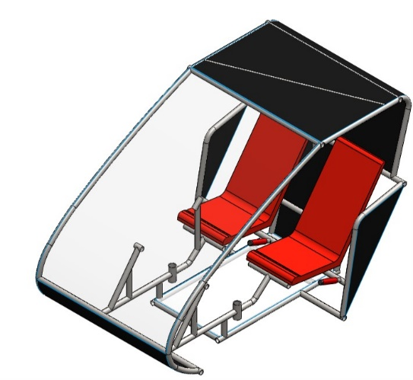
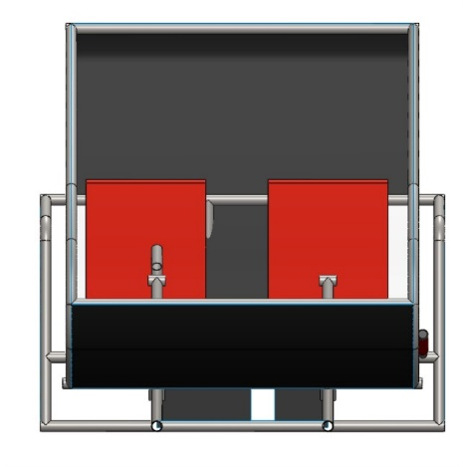
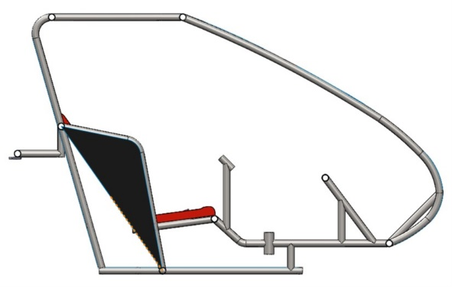
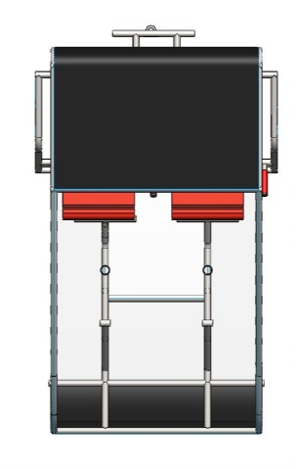
Frame, Seats and Other
15
Exploded view – Subsystem Assembly
Front view – Subsystem Assembly
Side view – Subsystem Assembly
Top view – Subsystem Assembly
Sectional/ Extra view – Wherever required for better understanding
Sectional/ Extra view – Wherever required for better understanding

Slide 19
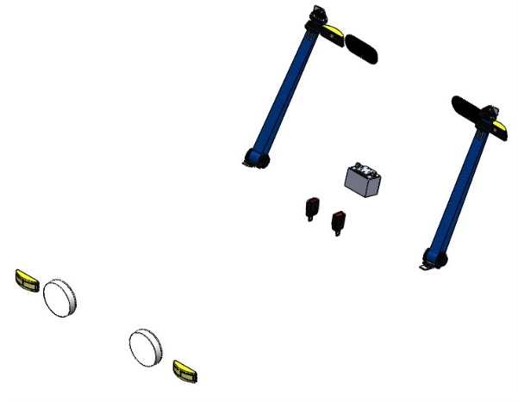
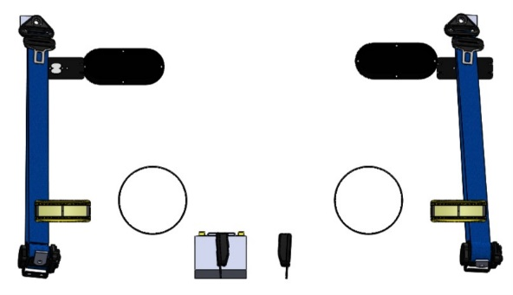
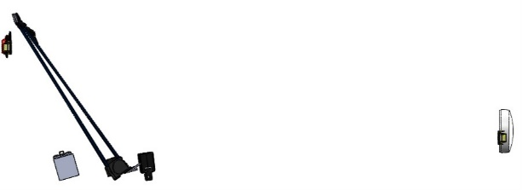
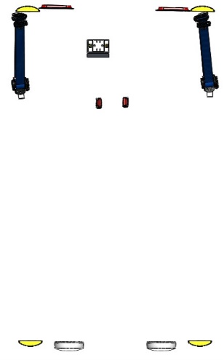
Electricals and Accessories
16
Exploded view – Subsystem Assembly
Front view – Subsystem Assembly
Side view – Subsystem Assembly
Top view – Subsystem Assembly
Sectional/ Extra view – Wherever required for better understanding
Sectional/ Extra view – Wherever required for better understanding

